Slide 1

Cloud Computing Large-scale Resource Management II
Eva Kalyvianaki ek264@cam.ac.uk

Slide 2
Contents
Apollo: Scalable and Coordinated Scheduling
for Cloud-Scale Computing,
by Eric Boutin, Jaliya Ekanayake, Wei Lin, Bing Shi, and Jingren Zhou, Zhengping Qian, Ming Wu, and Lidong Zhou, in OSDI 2014
Slides and material from the OSDI paper and its presentation from:
https://www.usenix.org/conference/osdi14/technical-sessions/presentation/boutin

Slide 3
Background
Cloud-scale jobs
Jobs are written using SCOPE, a SQL-like high-level scripting language, augmented with user-defined processing logic.
Job’s are represented by DAGs
Tasks are the basic unit of computation
Tasks are grouped in stages
Execution is driven by the scheduler

Slide 4
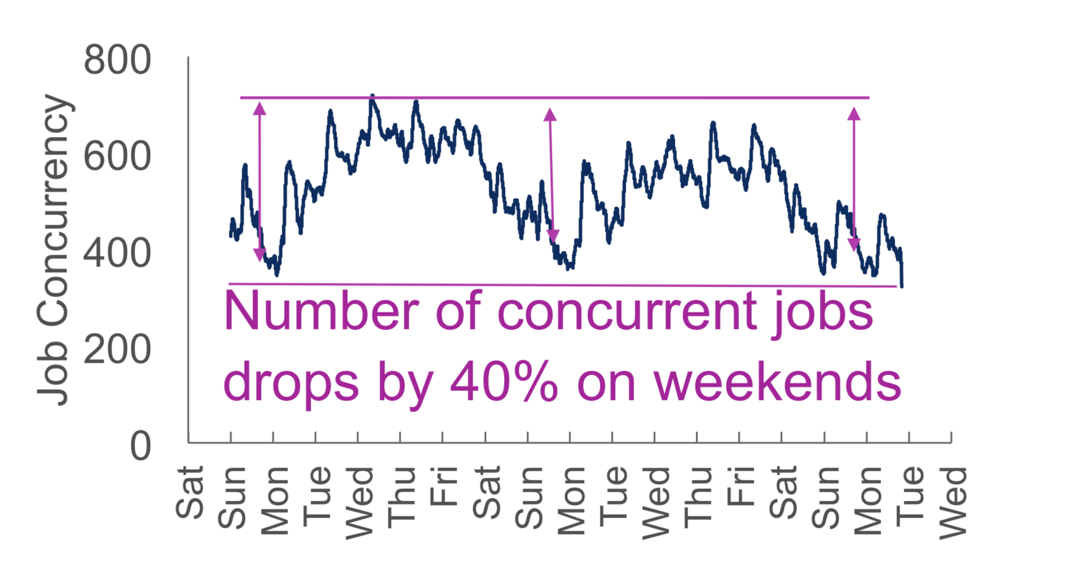
Scheduling at Cloud Scale
minimize job latency while maximizing cluster utilization
Challenges:
Scale
Jobs process gigabytes to petabytes of data, 100K scheduling req/sec
Clusters run 170K tasks in parallel and each has over 20K servers
Heterogeneous workload
Tasks run secs to hours
Can be IO or CPU bound
Require 100MB to 10GB of memory
Short tasks are scheduling sensitive
Long tasks are locality sensitive
Maximize utilization
Workload fluctuates

Slide 5
Apollo Overview
Distributed and coordinated architecture
Estimation-based scheduling
Conflict Resolution
Opportunistic Scheduling

Slide 6
Distributed and coordinated architecture

Slide 7
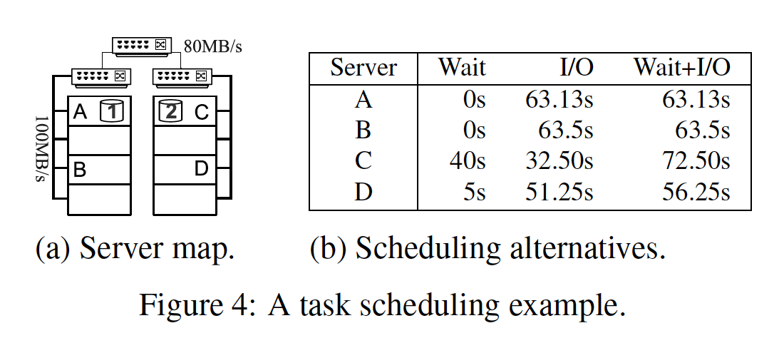
Different factors for optimization

Slide 8
Estimation-based scheduling
Estimated task completion time
Esucc = I + W + R
C = Psucc * Esucc + Kfail*(1−Psucc)*Esucc
E: Estimated task completion time
I: initialization time: fetching files for the task
W: wait time: a lookup in the wait-time matrix of the target server
R: Runtime: both I/O and CPU time

Slide 9
Conflicts Resolution
Apollo defers the correction of conflicts
(vs Omega where conflicts are handled at scheduling time)
Re-evaluates prior decisions
Triggers a duplicate if the decision is not optimal with up-to-date data

Slide 10
Opportunistic Scheduling
Maximize utilization
Use the remaining capacity
Dispatch more that the resource allocation
Tasks only consume idle resources
Tasks can be preempted or terminated
Tasks can be upgraded
Limit capacity share of each job
Random queueing

Slide 11
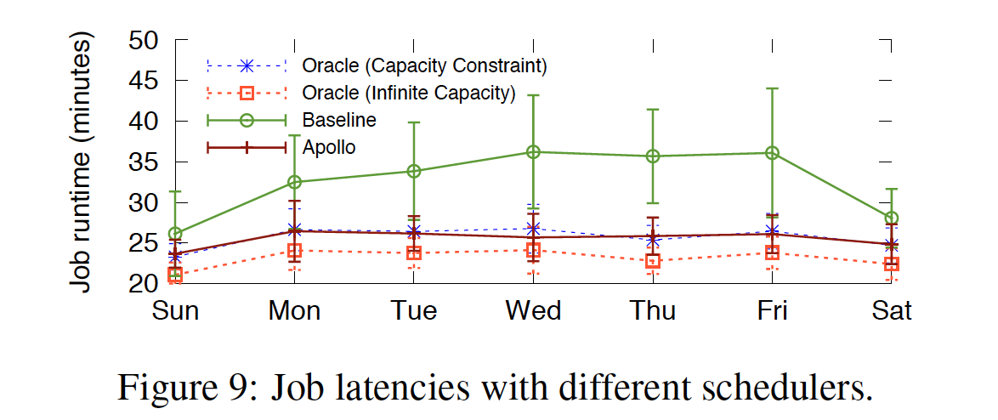
Evaluation
Apollo runs on Microsoft production clusters with over 20K servers each
It runs 170K tasks in parallel
Tracks 14M pending tasks

Slide 12
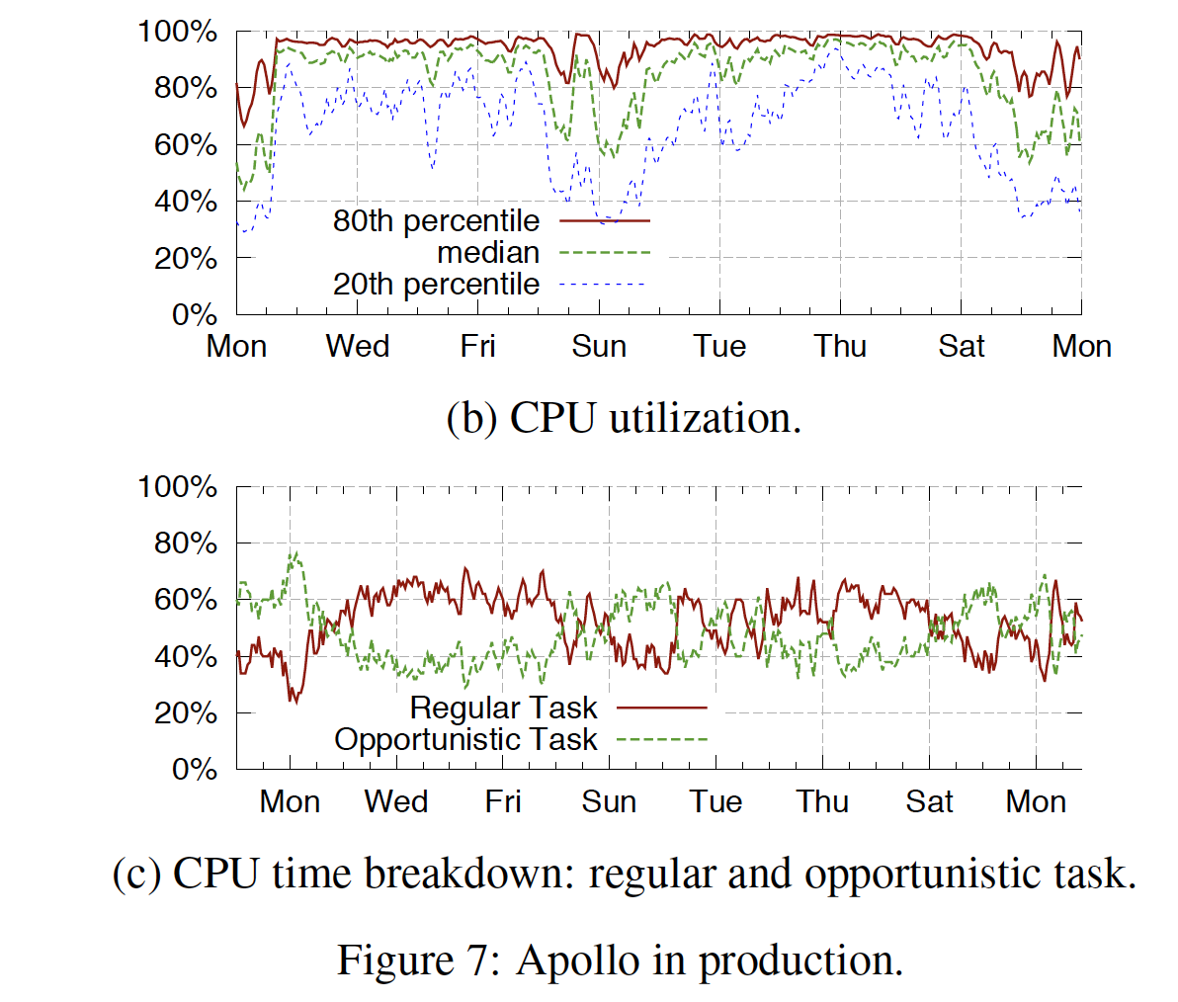
Apollo’s Resource Efficiency

Slide 13
Conclusions
Loosely Coordinated Distributed Architecture
Deployed to clusters with over 20K servers
High Quality Scheduling
Mininizes task completion time
Consistent performance
Maximizes resource utilization
Opportunistic scheduling
90% median CPU utilization

